Slide 1

Comparing Analysis Method Implementations in Software (CAMIS)
Christina Fillmore

Slide 2
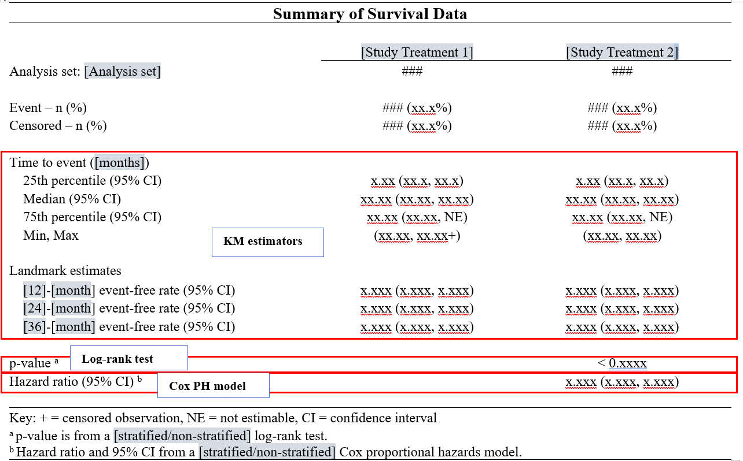
Motivation
SAP states:
Using a log-rank test determine to association between survival time and atrial fibrillation. Additionally, calculate Kaplan-Meier estimate of survival time and use Cox proportional hazard model to get the hazard ration and 95% confidence interval

Slide 3
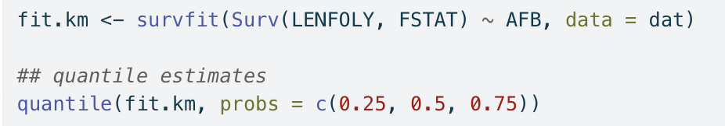
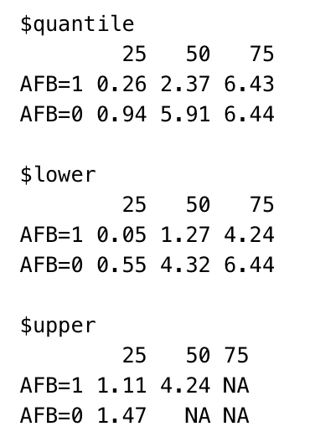

Motivation - results

Slide 4
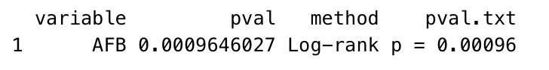
Motivation - results

Slide 5
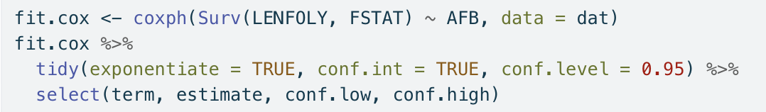
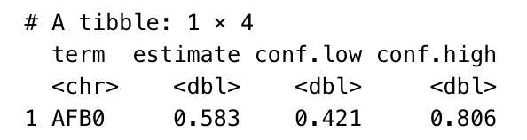
Motivation - results

Slide 6


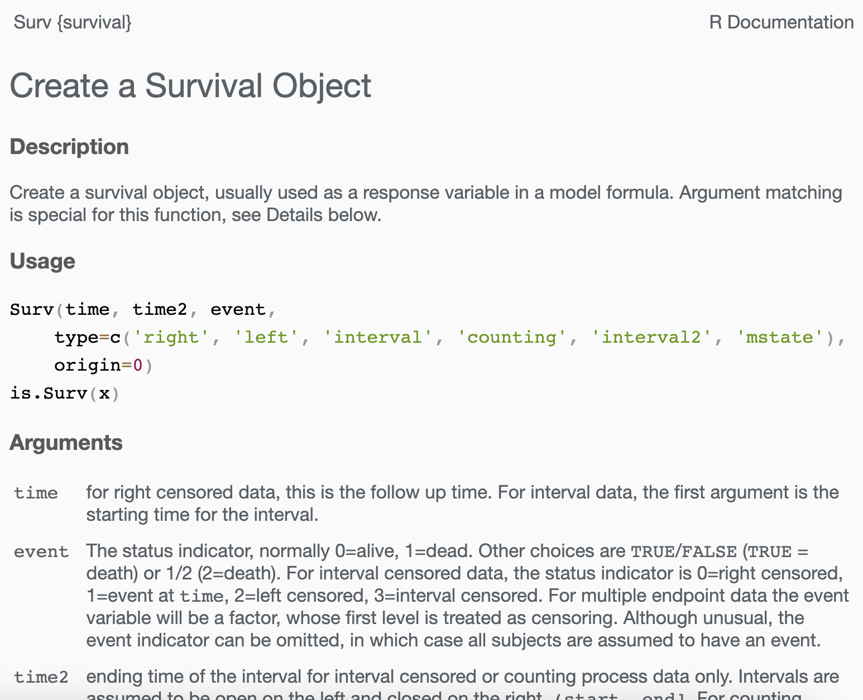
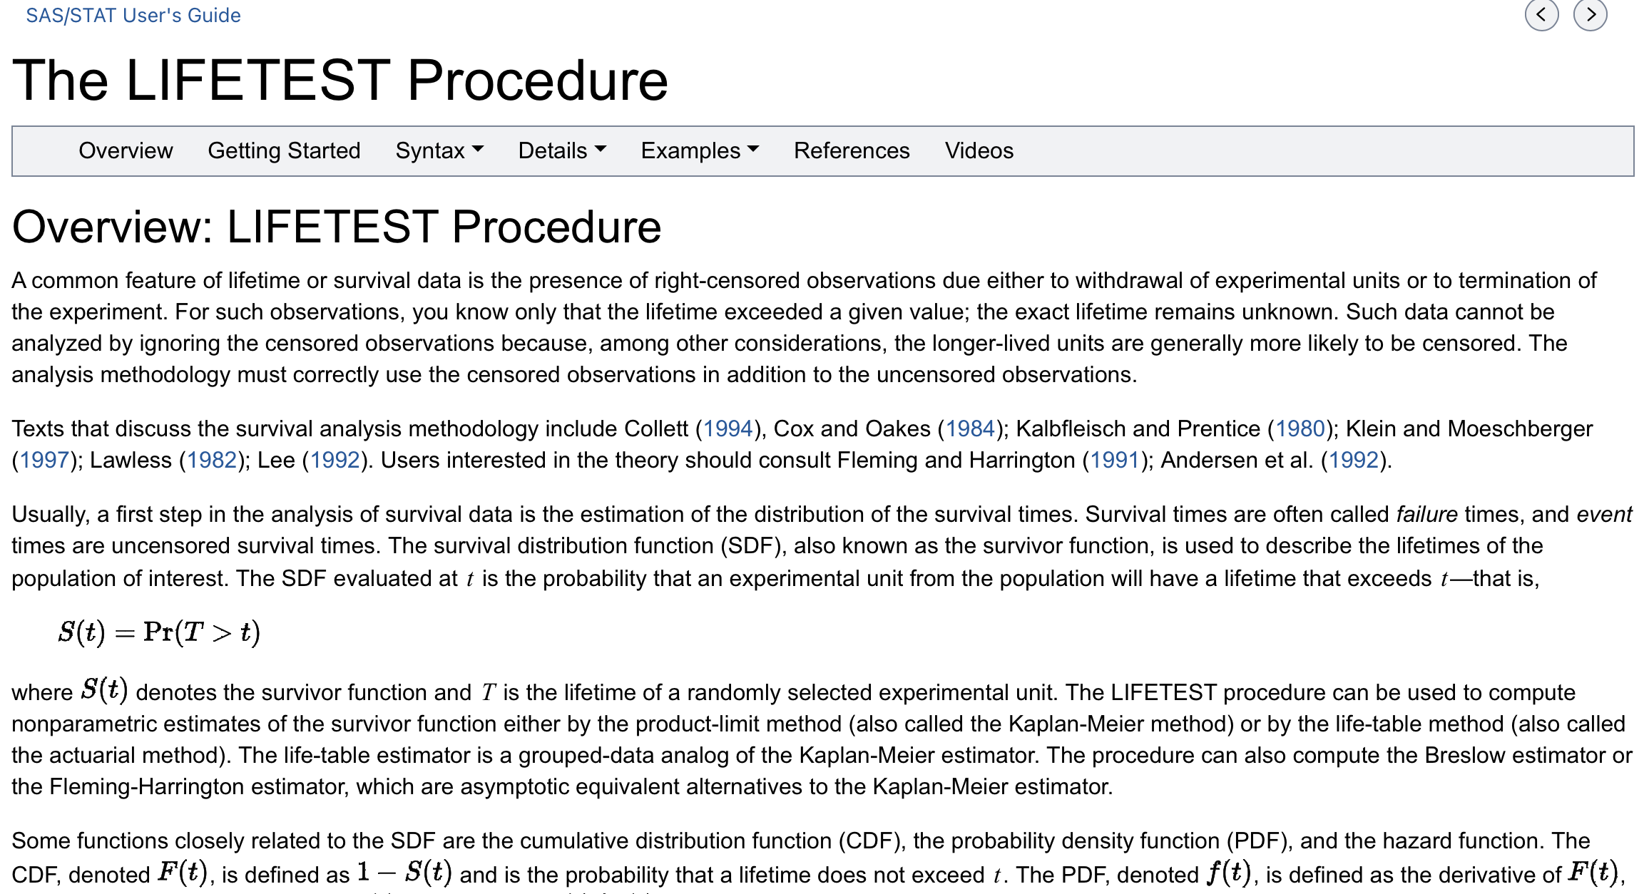
Motivation - Search

Slide 7



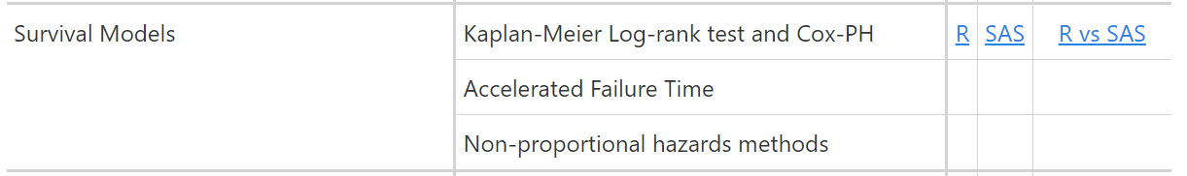
CAMIS

Slide 8
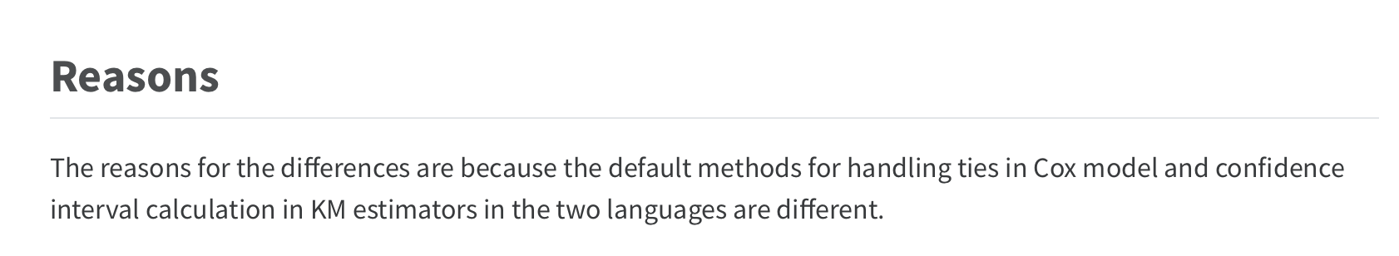
CAMIS
Notes:
RE: Efron & Breslow: Both options are available in R and SAS, so by simply changing the default method, we would expect an identical HR & CI.
The key point here is that you should be considering which is most appropriate for your analysis, and not just using the default. Brewlow easiest to program _hence was the first to be available in SAS and hence is the default.
Efron option is more accurate if there are a large number of ties, and it is the default in R. - If number of ties are small then the methods are indistinguishable.
RE: Log, log-log : no consensus on which is best. Both are in widespread use. Simulation studies suggest log-scale interval is better – closer to the nominal coverage – which is why its’ default in R survival package

Slide 9
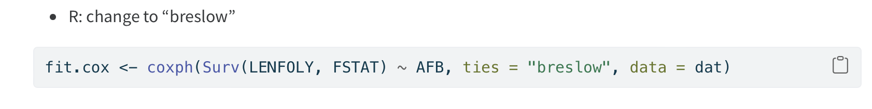
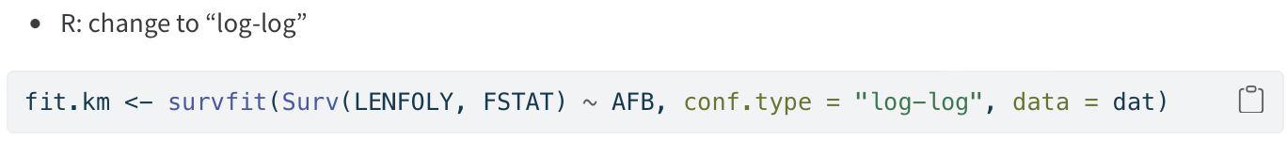
CAMIS
DEFAULTS
Notes:
RE: Efron & Breslow: Both options are available in R and SAS, so by simply changing the default method, we would expect an identical HR & CI.
The key point here is that you should be considering which is most appropriate for your analysis, and not just using the default. Brewlow easiest to program _hence was the first to be available in SAS and hence is the default.
Efron option is more accurate if there are a large number of ties, and it is the default in R. - If number of ties are small then the methods are indistinguishable.
RE: Log, log-log : no consensus on which is best. Both are in widespread use. Simulation studies suggest log-scale interval is better – closer to the nominal coverage – which is why its’ default in R survival package

Slide 10
CAMIS
Notes:
RE: Efron & Breslow: Both options are available in R and SAS, so by simply changing the default method, we would expect an identical HR & CI.
The key point here is that you should be considering which is most appropriate for your analysis, and not just using the default. Brewlow easiest to program _hence was the first to be available in SAS and hence is the default.
Efron option is more accurate if there are a large number of ties, and it is the default in R. - If number of ties are small then the methods are indistinguishable.
RE: Log, log-log : no consensus on which is best. Both are in widespread use. Simulation studies suggest log-scale interval is better – closer to the nominal coverage – which is why its’ default in R survival package

Slide 11
Welcome to the CAMIS repository !
CAMIS: Comparing Analysis Method Implementations in Software
A PHUSE DVOST working group project
A cross-industry collaboration formed of members statistical and programming associations such as PHUSE, PSI, IASCT and ASA.
Aims:
To create a white paper
To create a github repository to store how to apply statistical methods in various software and document any differences observed in the results obtained
Notes:
CAMIS stands for: Comparing Analysis Method Implementations in Software
This is a cross-industry collaboration formed of members statistical and programming associations such as PHUSE, PSI, IASCT and ASA. Anyone can be a contributor.
We have 2 Aims:
1) To create a white paper
2) To create a github repository to store how to apply statistical methods in various software and document any differences observed in the results obtained

Slide 12

White Paper

Slide 13
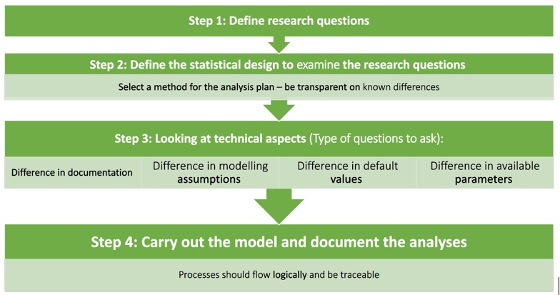
White Paper
Notes:
The white paper describes a 4 point process to ensure analysis is clearly specified such that it isn’t reliant on software default settings which can change across software
Goes through the survival example we covered today
The SAP the we used wasn’t detailed enough, kind of like going to a pizza shop and just asking for pizza without the information about tie handling and how to calculate quantile the analysis isn’t reproducible from the SAP

Slide 14
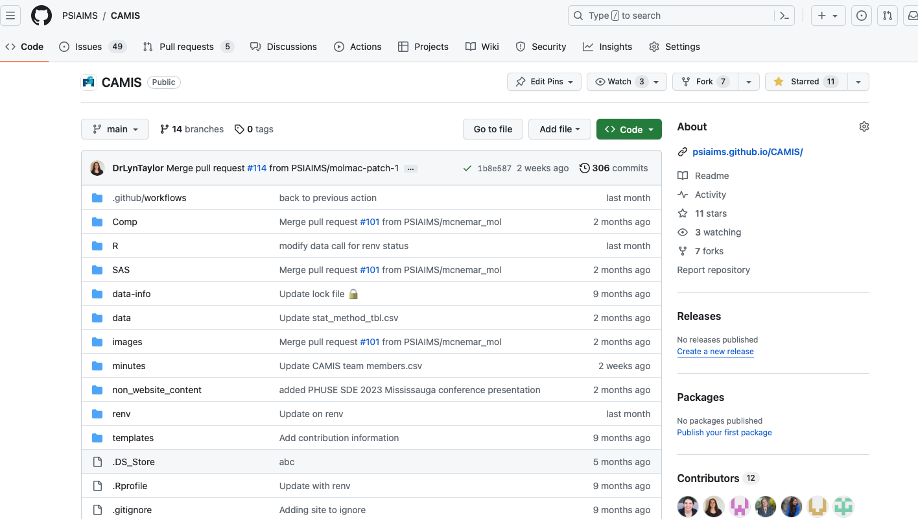

Slide 15
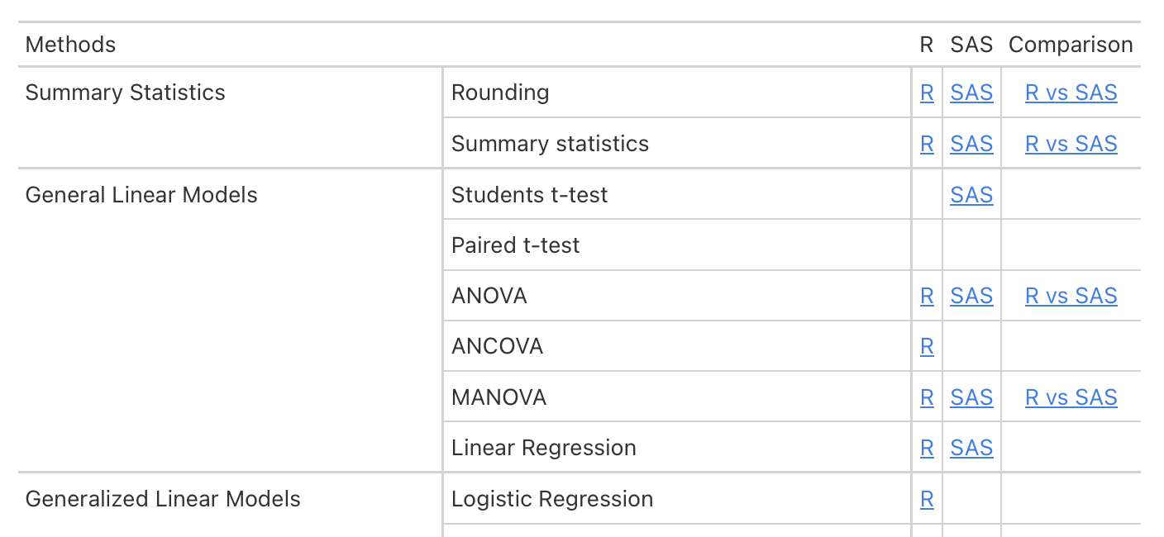
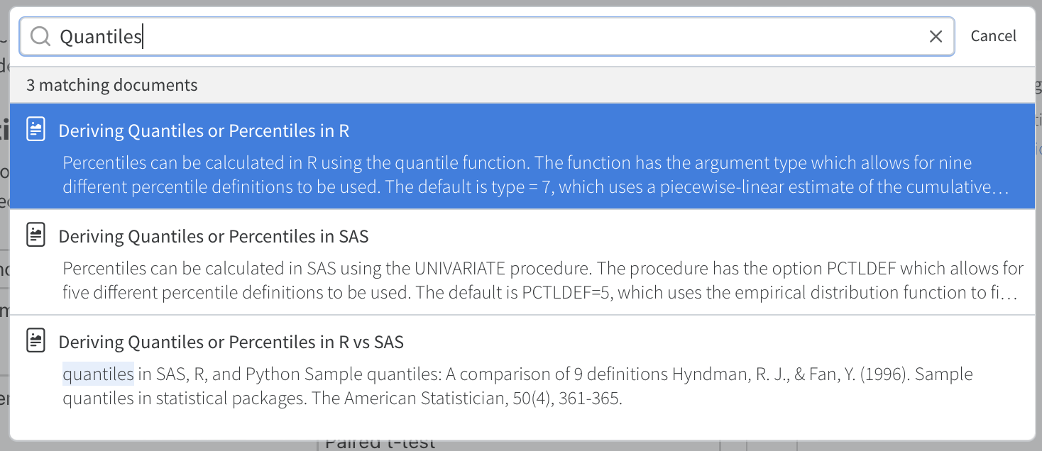
Website - How to Use it

Slide 16
Call for Action – How you can help?
Documenting how to perform statistical methods in R, SAS or comparing them
Adding to the repository differences between R & SAS that know about
You can be a contributor or JOIN US on the PHUSE working group
Adding content for Python, Julia or other software
Review/ revision of existing CAMIS content.
Notes:
This presentation is a call for Action - so here is how you can help us to build a high quality comprehensive repository.
Would you be interested in documenting how to perform a statistical method in R, SAS and comparing them? Our github repo has a list of issues awaiting investigation. If you would like to contribute to a specific are then please get in touch to be assigned.
Do you already have some content that you would like to load to the site which documents some difference between the was SAS and R do statistical analysis. If so please get in touch and we can show you how to load to the site
Do you want to explore other software?
Are you a statistical expert and would like to review our content to ensure our methods and documented correctly. Then please review our existing CAMIS content and do a pull request to suggest changes/ corrections.
This is a community led effort so the more people we have contributing the more comprehensive the project can become.
You can be a contributor or join the PHUSE working group which meets monthly.

Slide 17
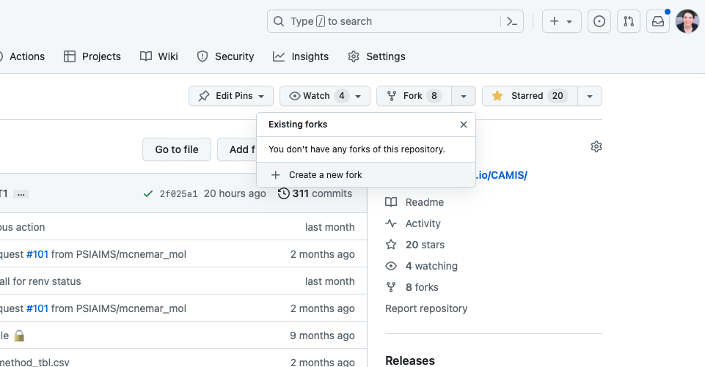
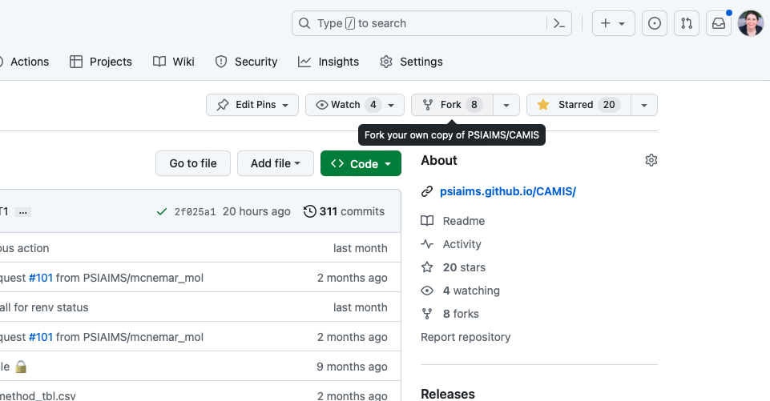
Website - How to Contribute

Slide 18
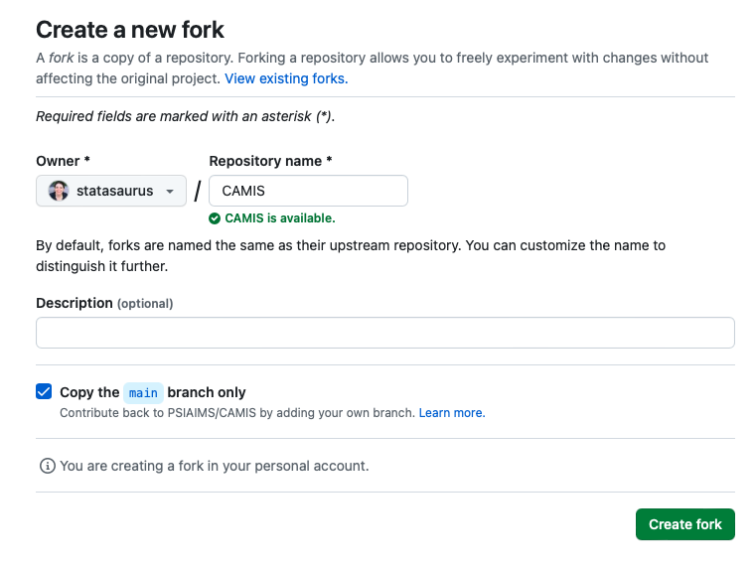
Website - How to Contribute

Slide 19
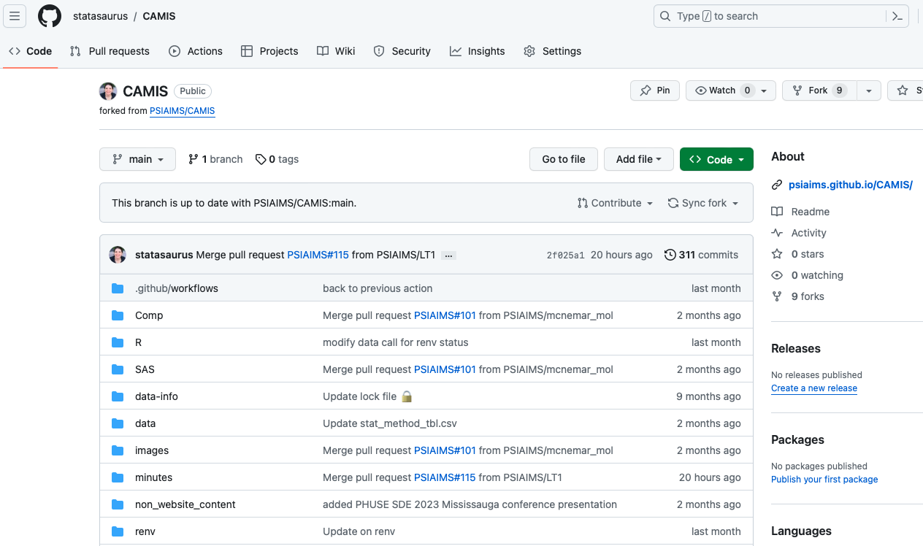

Slide 20
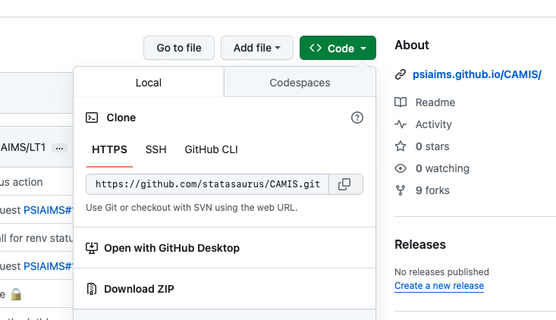
Website - How to Contribute

Slide 21
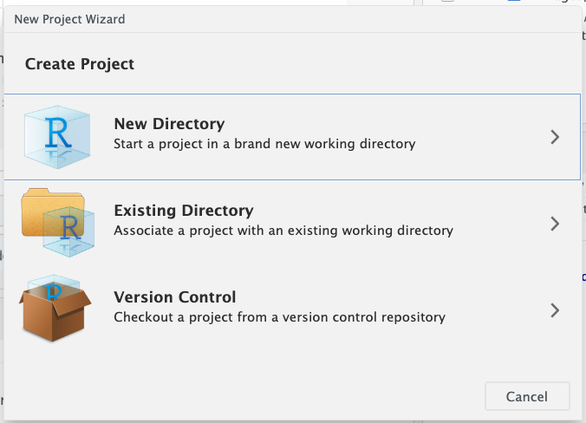
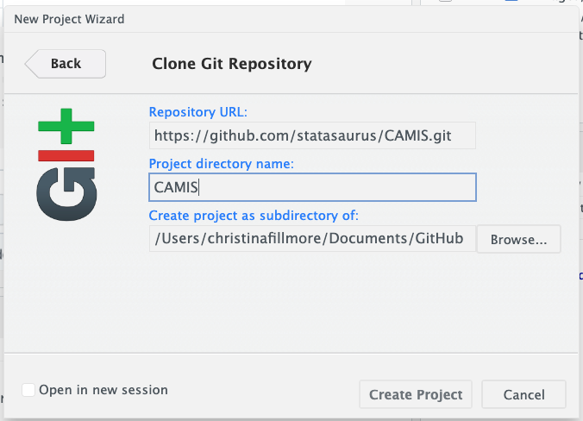
Website - How to Contribute

Slide 22
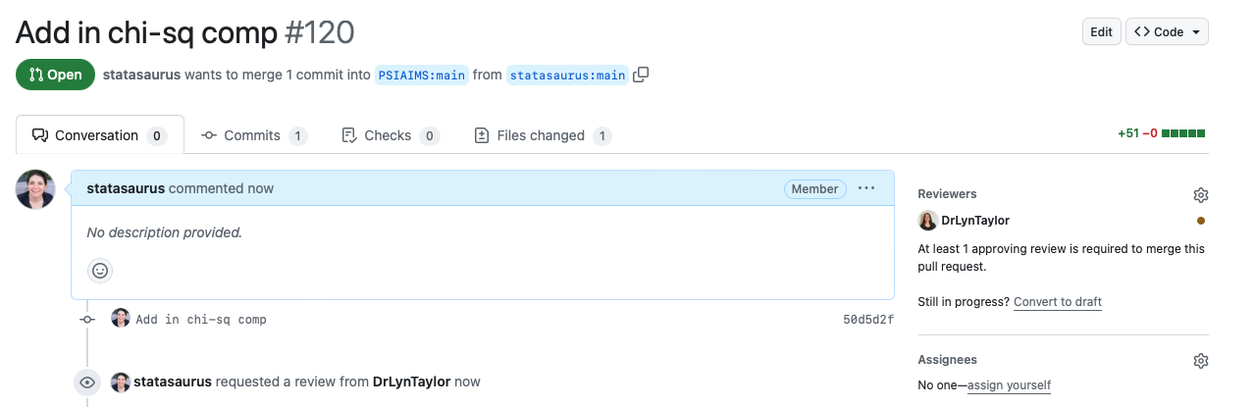
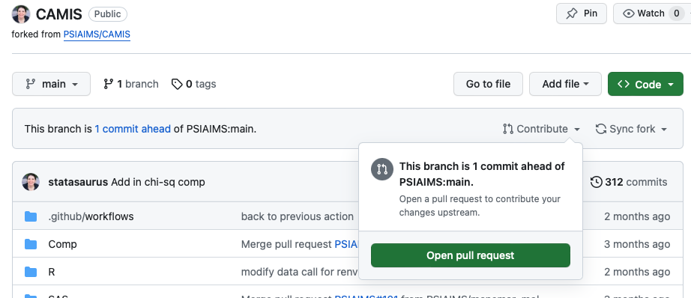
Website - How to Contribute

Slide 23

Summary
CAMIS is here to help
… but, we need your help too

Slide 24
Thank you

